Slide 1
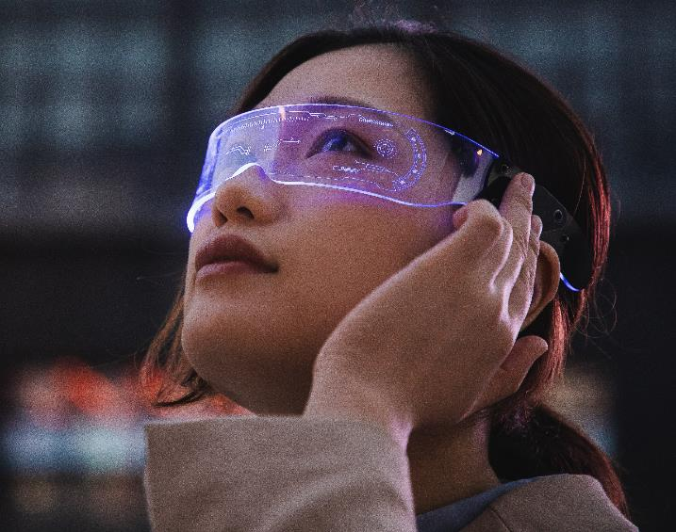
VR Gaming Market analysis Presentation
By: Humza Sheikh

Slide 2
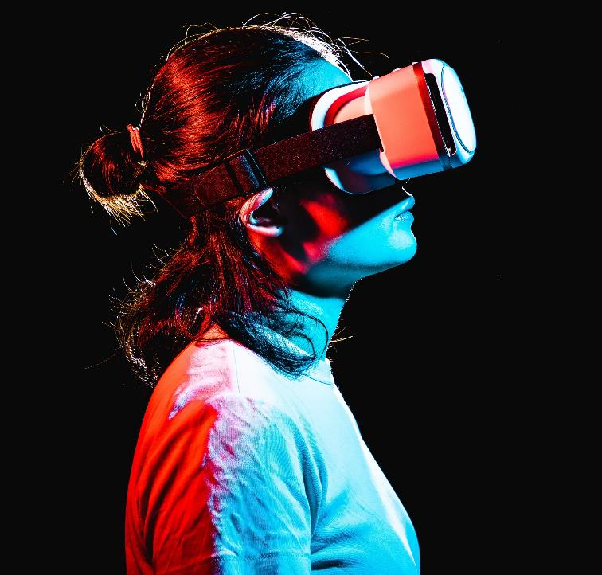
Introduction
This presentation will briefly summarize the market analysis report, focus on the market overview and growth, trends and problems, key player and headsets, and the future

Slide 3
Key Findings

Slide 4
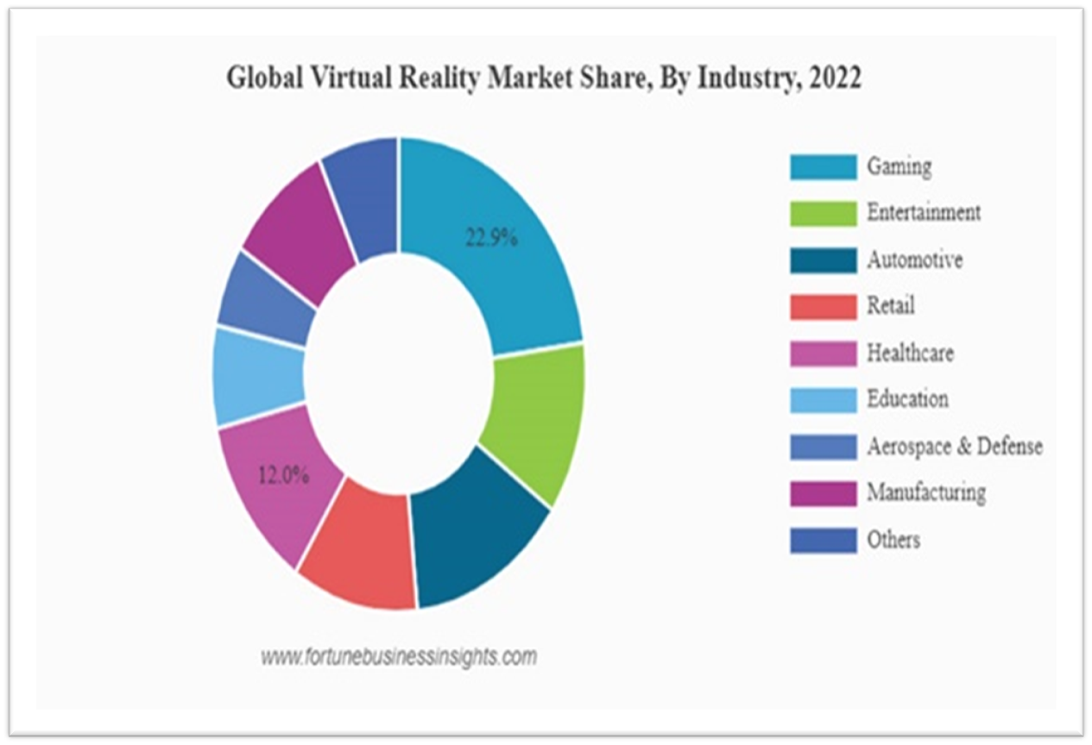
Market Overview and Growth
The gaming sector holds a 22.9% market share in the Global Virtual Reality Market Share in 2022.
In the same year, the market was valued between $17.25 and $19.44 billion U.S. dollars.
The market will estimate to grow around USD $130.05 billion from 2023 through 2028
The rapid popularity of the VR genre and big companies like Sony, Meta, Microsoft investing heavily in the sector are one of many factors that help grow the market rapidly.

Slide 5
Market tRENDS
The current trend, is to improve the hardware continuously and, at the same time, reduce the price as well as make it more accessible.
Future direction is developing brain-computer interfaces (BCIs) which allow users to control VR experiences with their thoughts, eliminating the need for a controller
Another future trend is to integrate AI and machine learning in games
The future trend is making stronger effort in accommodating people who have disability with lighter and more comfortable headsets and more accessible software for people with disabilities (Full Scale, 2023).

Slide 6
KEY Players
I have highlighted two gaming development companies, if you are interest learning more, check out the full report
Valve Corporation:
- Famous and Well-known titan of the gaming industry for developing and publisher games,
creating steam: the largest digital vendor of video games.
- Famous for the Half-Life, portal, Left 4 dead and many other franchises
- Well-known player in the VR industry and have been successful creating their own
VR headset the index and at the same time collaborating with Hp and HTC on their respective headsets.
ILM X LAB:
- Studio that was founded in 2015 by the biggest visual companies in the business, Industrial light & Magic (ILM), ILM was
founded by George Lucas and the company is responsible for providing outstanding special effect for more than 400 films.
- Dedicated to creating visual stunning, immersive game with their famous Ip’s, Star Wars, Marvel and others.
- Vader Immortal: A Star Wars VR Series and Tales from the Galaxy’s Edge are most notable and successful titles
from the studio.

Slide 7
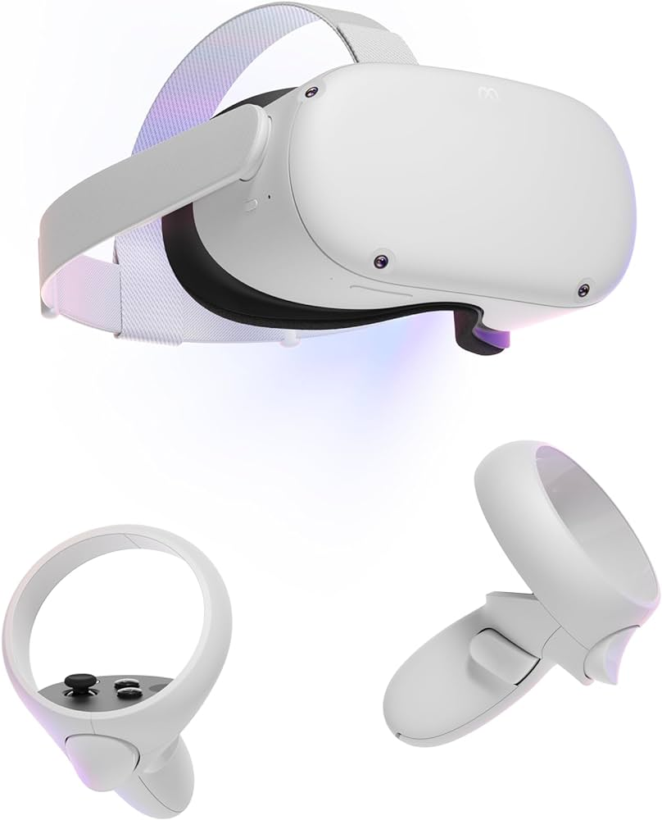
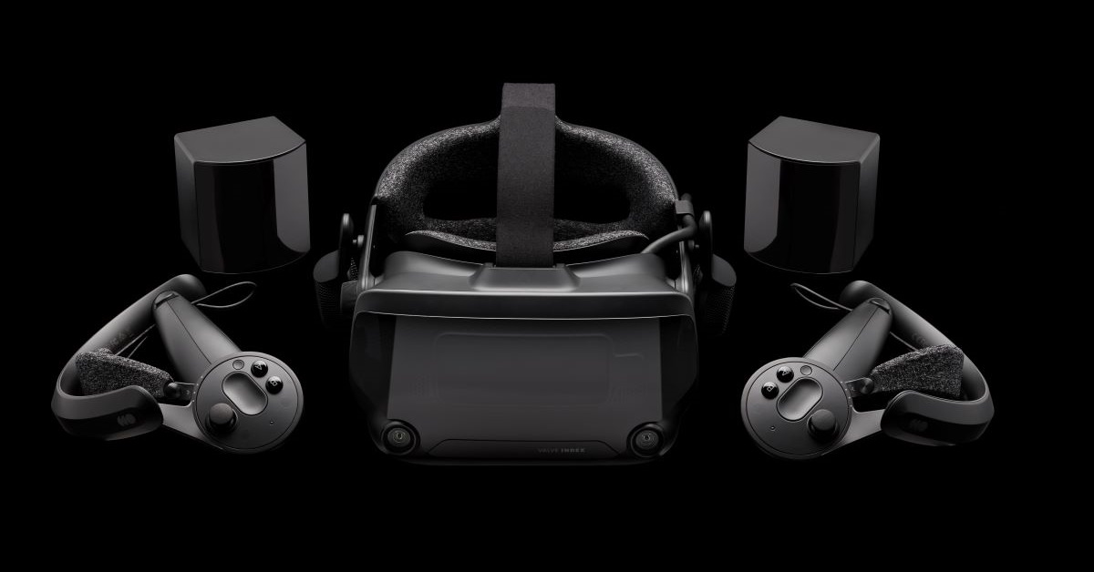
Headsets
Meta/Oculus Quest 2
Valve index
The Meta/Oculus Quest 2 is one the most accessible headsets to start your VR journey because it does not require the user to own pc or a console, just an app on your phone. Includes everything you need out of the box and affordable. Valve index, Sony PSVR2, and HP Reverb G2 are great options, each with their own pros and cons.
Index is an excellent headset if you want a much more powerful headset without breaking the bank.
VAR labs have plenty of experience with the Index and Steam by developing their learning simulators.

Slide 8
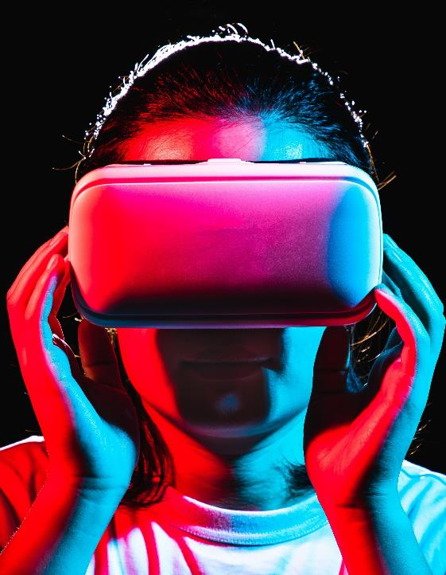
The Future/Summary
The future looks promising, focusing on making the headset more affordable over time and accessible.
The constant evolution of the hardware and immersive titles will be the main driving force in growing the sector.
In summary, the VR gaming market is on an upward trajectory, characterized by innovation, user demand, and the significant influence of key players and platforms.
VR gaming promises an exciting future with immersive experiences and boundless possibilities for gamers.

Slide 9

References
Research​
We based our research on market trends and software sales ​
Abstract​
We believe people need new management tools to help businesses achieve their OKRs​
Design​
Minimalist design and easy to use ​

Slide 10
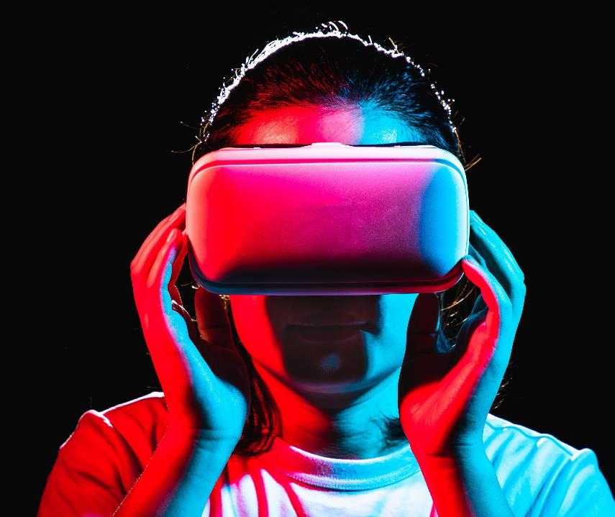
Thank you
Mirjam Nilsson​​
206-555-0146​
mirjam@contoso.com​
www.contoso.com​

